Slide 1

PYTHON 4
DATA SCIENCE
WIRED Monash
Notes:
Welcome address
Are we all mainly first years again
So before we get started can I please get a show of hands how many of you guys have taken FIT1043?
But yes…
a lot of what we teach is gonna overlap with FIT1043, which I think isn’t designed too badly it's just unfortunate that the teaching team is horrible (welcome to Monash University)

Slide 2
Workshop Objectives
01
02
03
What is it?
Libraries
Analysis
Understand what is Data Science and the role of Python in Data Science
Get familiar with key Python libraries like NumPy, Pandas, and Matplotlib
Perform basic data analysis and visualization using real world datasets
Notes:
Understanding what it is
What are libraries which is gonna open up a complete new world for you guys in your programming journey and thats when i think things get fun also
We’re also gonna take you thru the steps we use to perform data analysis and visualisation

Slide 3

What is Data Science?
Key Components
Field of using data to extract insights, solve problems, and make decisions using programming, math, and domain knowledge.
📊 Data Analysis – Understanding and interpreting data
🤖 Machine Learning – Making predictions and automating decisions
📈 Visualization – Creating graphs and dashboards to explain data
💾 Data Engineering – Preparing and cleaning data for analysis
Notes:
“Alright, so let’s start with the big question — What actually is Data Science? In simple terms, Data Science is all about using data to understand things, solve problems, and make better decisions. It’s kind of like being a detective, but instead of solving crimes, you’re solving questions using data!
Data Science brings together a mix of skills — programming (like Python), a bit of math and stats, and domain knowledge — which means understanding the field you’re working in, whether it’s finance, healthcare, or sports.
There are four main things Data Scientists often do:
Data Analysis — this is exploring the data and trying to understand what it tells us.
Machine Learning — training models to make predictions, like predicting if someone will like a song.
Visualization — turning numbers into charts so it’s easier to explain.
Data Engineering — preparing and cleaning messy data so it’s ready to use.
Now some of you may ask well hang on, “I’ve seen these jobs advertised on their own before, whats the deal with that”
That’s a great question, so in industry, you’ll often hear ‘Data Science’ used as a big umbrella term. But depending on the company and the size of the team, these tasks — analysis, engineering, machine learning — can become separate specialized jobs.
In smaller startups, one person might do everything. In big tech companies, each of these can be a full-time role with its own title: data analyst, data engineer, machine learning engineer, and so on.

Slide 4
Data Science Process
Understanding
Data Cleaning
Build Model
Deployment
Data Collection
EDA
Evaluate Model
Communicate Result
Notes:
So what is this data science process thing
It’s the step-by-step journey/convention we follow to turn raw data into meaningful insights and decisions.
It all starts with a question. Maybe a business wants to know why sales are dropping, or you're wondering who’s most likely to survive on the Titanic.
Next, we collect data — this could come from a CSV file, a database, an API, or even scraping the web.
Once we have the data, we need to clean it. Real-world data is messy — it might have missing values, errors, duplicates, or the wrong data types. Cleaning is often the most time-consuming step.
Then comes EDA — or Exploratory Data Analysis. Here, we start playing with the data, using charts and summary stats to understand what’s going on. This step helps us figure out what features matter, and maybe even gives us some surprising insights.
Once we understand the data, we may choose to build a model — especially if we want to predict something, like prices, survival, or customer churn.
After building the model, we need to evaluate how good it is. Is it accurate? Is it overfitting? Do we trust it?
MISSED THIS STEP CBF FIXING
Now here’s a step many beginners skip — deployment. This is about taking your model and putting it into the real world. Maybe it's powering recommendations on a website, or it’s exposed through an API. It’s how your model becomes useful — not just something that runs in a notebook.
Finally, we communicate our results — maybe through visualizations, dashboards, or a summary report — and we iterate. You get feedback, retrain with new data, improve your approach, and repeat.
The key thing to remember is — data science isn’t just about code or math — it’s about solving real problems, and making sure your solution is actually usable. That’s why deployment is such an important piece.

Slide 5

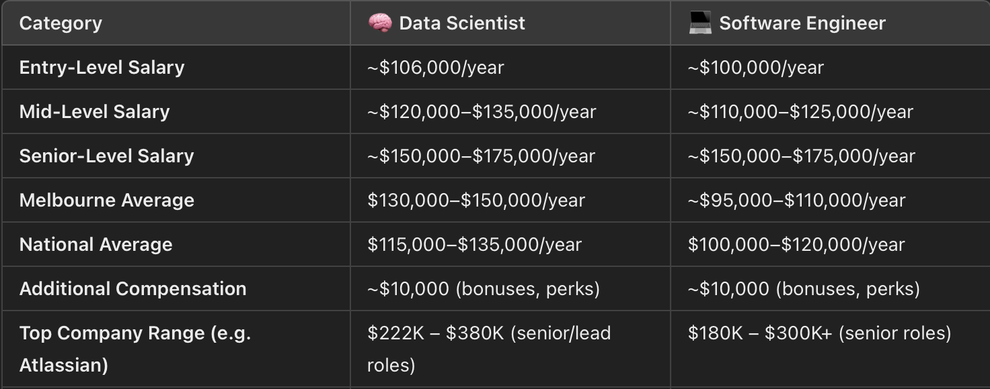
Salary in Data Science
Average Salary
Influencing factors
$115-135/yr - Seek
⏳ Experience Level: Salaries tend to increase with experience. For instance, a Senior Data Scientist can expect higher compensation compared to an entry level position.​
🏢Industry and Company Size: Larger organizations or those in high demand industries may offer higher salaries.​
🌍Location: Salaries can vary between cities and states (Melbourne offers higher average salaries compared rest of Australia).​
Comparison
Notes:
“Now let’s take a quick look at something everyone’s curious about — salaries.
Now knowing that many of you guys are first years and probably still somewhat making your decision between the different majors, disclaimer that’s not to say that if you major in one thing you can’t do the other thing. Ultimately its about how qualified you are for the role which you demonstrate through your interests and effort outside of class. You’ll soon realise that what you do in your course ultimately matters very little in getting you through the door.
Again not saying that money should determine what major you choose, in fact it shouldn’t. But then again anyone that says they don’t care about money in their job is lying straight to your face!
Starting with Australia — interestingly, here, Data Scientists often earn slightly more on average. The average base salary for a Data Scientist is around $115K to $135K, and in Melbourne, it can go up to $150K. For Software Engineers, the national average is a bit lower, around $100K to $120K, though of course it depends on your level and the company.
The trend is flipped in the US
So why this difference?
In the US, software engineering is deeply tied to product development and scalable systems — it’s the engine room of most tech companies. But in Australia, data science is still a growing field, and skilled professionals are in shorter supply — so they can command slightly higher salaries on average.

Slide 6

Libraries
Collection of modules — reusable code that you can import into your programs to avoid writing everything from scratch.
Term | Description | Example
Modules | A single Python file with functions | math, random
Packages | A collection of modules in a folder | pandas, numpy
Libraries | multiple packages/modules that work together | scikit-learn, matplotlib
Frameworks | A full structure for building apps | django, flask
Notes:
Now before we really get into the data science pt of the workshop, lets what’s gonna start making python useful. You can think of a library as a toolbox. It comes with ready-made tools — like functions or objects — that save you time and effort. Instead of writing everything from scratch, you import a library and start building right away. We use them because it’ll be way too tedious and complication to implement everything from the ground up/scratch. So often we’ll just use these functions provided by the library and take it for granted (ensures that the code is well tested and optimized the ppl that build these things are smart!!)
In this workshop, we’ll be focusing on some essential data science libraries: NumPy for arrays, Pandas for data tables, and Matplotlib or Seaborn for visualizations.
These libraries are what make Python super powerful for data science — and by the end of this session, you’ll be using them confidently!”
Module = Brick
The smallest building block in software is the module. Just like a single brick, it's a small piece of code that performs a specific task. Modules can be functions or methods, and they can be reused throughout your program.
Package = Wall
A package is like a wall – a collection of bricks working together. It a folder of related modules that perform similar tasks. Packages help organize your code and make it easier to manage.
Library = House Plans
📦 Package vs Library (Simple Explanation)
📦 Package = A folder of related Python files (called modules) that you can install and use.
📚 Library = A collection of packages or modules, usually designed for a specific purpose.
🧠 Think of it like this:
A package is like a single app on your phone. A library is like a whole toolkit with multiple apps that work together.
✅ Example:
pandas → is a package for data analysis
scikit-learn → is a library made up of many packages for machine learning
Framework = Pre-Built House
Think of a framework as a pre-built house. It provides a complete structure with predefined walls, plumbing, and electrical systems (think core functionalities). While you can't change the overall layout, you can customize the interior (your specific program logic) to fit your needs. Frameworks enforce certain design principles and offer a faster way to build applications.

Slide 7


NumPy
Python library used for numerical computing, especially with multi dimensional arrays
(ndarrays)
import numpy as np
a = np.array([1, 2, 3])
print(a + 10) # Output: [11 12 13]
b = np.array([[1, 2], [3, 4]])
print(np.mean(b)) # Output: 2.5
🚀 Much faster than Python lists
📏 Great for matrix operations, statistics, and linear algebra
💻 Backbone for many other libraries (Pandas, SciPy, Scikit-learn)
Notes:
“Now let’s talk about NumPy, which stands for Numerical Python.
NumPy is one of the most important libraries in data science because it lets us work with large arrays of numbers efficiently — way faster than using Python lists.
NumPy is also the foundation of many other data science libraries — Pandas, SciPy, scikit-learn — they all use NumPy under the hood.
So even if you don’t use it directly all the time, understanding how NumPy works will help you understand how all the other tools work too.
Vectorization means doing operations on entire arrays or lists of data all at once, instead of using a loop to go through one item at a time.
Real-Life Analogy:
Imagine giving everyone in a classroom a 10-mark bonus —
Non-vectorized way: Go to each person one by one and add 10.
Vectorized way: Announce “+10 for everyone!” — and it’s done instantly.
“Vectorization is one of the reasons NumPy is so fast. Instead of looping through data, it applies operations to the whole array at once.
It’s like upgrading from manual to automatic—and that’s why we love NumPy!”

Slide 8

pandas
Go to Python library for working with structured data, like spreadsheets or CSV files. It provides two main structures:
import pandas as pd
df = pd.read_csv("titanic.csv")
print(df.head()) # First 5 rows
print(df["Age"].mean()) # Average age
print(df.groupby("Sex").Survived.mean())
# Survival rate by gender
⚙️ Easy data loading (CSV, Excel, SQL, JSON)
🔋 Powerful tools to clean, filter, and group data
🔢 Supports missing values and datetime types
Notes:
“Next up, we’ve got Pandas — one of the most popular libraries in Python for working with structured data.
Think of Pandas as your Python-powered spreadsheet tool — it lets you load, explore, clean, and analyze tabular data really easily.
The core idea in Pandas is the DataFrame.
A DataFrame looks like an Excel table — rows and columns, labeled and easy to work with.
One of the best things about Pandas is that it’s built on top of NumPy, so it’s fast, and it plays really well with other libraries like Matplotlib and scikit-learn.
You’ll be using Pandas in almost every data science project, from beginner to advanced.
So once you get comfortable with it, you’ll feel way more confident working with real-world datasets.”

Slide 9

Matplotlib
Data visualization library.
It lets you create charts and graphs — just like Excel, but with code.
import matplotlib.pyplot as plt
x = [1, 2, 3, 4]
y = [10, 20, 25, 30]
plt.plot(x, y)
plt.title("Simple Line Plot")
plt.xlabel("X-axis")
plt.ylabel("Y-axis")
plt.show()
📊 Create custom plots: line charts, bar charts, scatterplots, etc.
🏷️ Control every part of your chart — colors, labels, titles, axes
📈 Base for other libraries like Seaborn and Plotly
Notes:
Matplotlib is Python’s most popular library for creating charts and graphs.
It lets you visualize your data so you can better understand it — or explain it to others.
Create all kinds of plots: line, bar, scatter, histogram, pie
Fully customizable: colors, labels, titles, gridlines
Works great with Pandas and NumPy
Foundation for libraries like Seaborn and Plotly

Slide 10
LIVE
DEMO

Slide 11

Additional RESOURCES
Kaggle
Library official documentation
W3Schools
Python tutor
freeCodeCamp

Slide 12
-Ronald H. Coase
"Torture the data, and it will confess to anything."
Notes:
“This quote by W. Edwards Deming — a pioneer in statistics and quality control — really sums up the power of data science. In a world full of guesses, biases, and assumptions, data gives us clarity. It lets us test ideas, challenge opinions, and make decisions based on evidence — not just gut feeling.
Whether you're analyzing customer behavior, predicting stock prices, or improving public health, data turns questions into answers. And that’s what makes data science so powerful — it gives you the tools to turn noise into knowledge.

